Slide 1
The Value of Integrating Trauma-Informed Approaches to Improve Care and Services
Women and Trauma Federal Partners Committee
Washington, DC
June 25, 2015
Michelle Hoersch, MS
Office on Women’s Health – Region V
U.S. Department of Health and Human Services

Slide 2
Office on Women’s Health
Vision
All women and girls achieve the best possible health
Mission
The Office on Women's Health provides national leadership and coordination to improve the health of women and girls through policy, education
and model programs.

Slide 3
Trauma-Informed Approaches
Vision
To equip every health and social service provider and institution with the knowledge, resources and support to provide services that are gender-responsive and trauma-informed so as to provide the best possible care for trauma-affected individuals

Slide 4
Collaboration
Sheela Raja, PhD
Clinical Psychologist and Assistant Professor University of Illinois – Chicago

Slide 5
Functional Definition of Trauma
Trauma occurs whenever an external threat
overwhelms a person’s coping resources.
Non-consensual
Victim is in discomfort, fear, feels intimidated
Bodily integrity (or that of someone else) is threatened

Slide 6
SAMHSA’s Definition of Trauma The 3 E’s
Event
Experience
Effect

Slide 7
Effects of Trauma
Inability to cope with the normal stresses of daily life
Difficulty trusting others
Difficulty managing emotions
Memory and attention deficits
Behavior changes
Altered neuro-physiology
Health impairment

Slide 8
My interest in trauma…
…began with a trip to site visit a prison

Slide 9
How common are traumatic exposures?

Slide 10
Prevalence of Trauma in the U.S. Rape and Sexual Assault
One out of every 6 American women has been the victim of an attempted or completed rape in her lifetime
That’s approximately 18 million American women
^{Source: RAINN}

Slide 11
Prevalence Child Abuse in America
Hidden epidemic of child abuse and neglect.
Every year more than 3 million reports of child abuse are made in the United States involving more than 6 million children.
The United States has one of the worst records among industrialized nations – losing on average between four and seven children every day to child abuse and neglect.
Source: Childhelp.org

Slide 12
Prevalence of Trauma in the U.S. Intimate Partner Violence
Nearly one in three adult women experience at least one physical assault by a partner during adulthood.
Men who have witnessed their parents' domestic violence are twice as likely to abuse their own spouse or partner compared to children of non-violent parents.
Girls who have witnessed domestic violence are more likely to stay in an abusive relationship as an adult.
More than 50% of batterers also abuse their children or their victim’s children.
Report of the American Psychological Association Presidential Task Force on Violence and the Family, (1996)
www.nyawc.org

Slide 13
Prevalence of Trauma in the U.S. Childhood Sexual Abuse
By the age of 13…
At least two out of every ten girls
and
One out of every ten boys
are sexually abused

Slide 14
Military Sexual Trauma
While 1 in 6 civilian women experience sexual assault, for military women this number climbs to approximately 1 in 3
Sadler et al. 2003. “Factors Associated With Women’s Risk of Rape in the Military Environment.”
American Journal of Industrial Medicine 43:262-273.

Slide 15
Elder Abuse
6% of older people report significant abuse in prior month
25% reported experiencing significant psychological abuse including financial control and medical neglect by caregivers

Slide 16
Trauma in the U.S. Natural Disasters and Terrorism
Sandy Hook Elementary School
Hurricane Sandy
Tornados
9/11
BP Deep Water Horizon
OKC bombing
No one who sees a disaster is untouched by it.

Slide 17
Trauma in the U.S. Historical Trauma
American Indians and Alaska Natives
Robbed of culture
Boarding schools

Slide 18
Trauma in the U.S. Intergenerational Trauma

Slide 19
Prevalence of Trauma in the U.S.
Very common that an individual will have exposure to
multiple traumatic events during their lifetime.

Slide 20
Toxic Stress and Trauma
Notes:
Toxic stress and Trauma
Slide shows three rectangular-shaped boxes, one on top of the other, in different colors with the following words:
Green box: Positive: Brief increases in heart rate, mild elevations in stress hormone levels.
Orange box: Tolerable: Serious, temporary stress responses, buffered by supportive relationships.
Red box: Toxic: Prolonged activation of stress response systems in the absence of protective relationships.

Slide 21
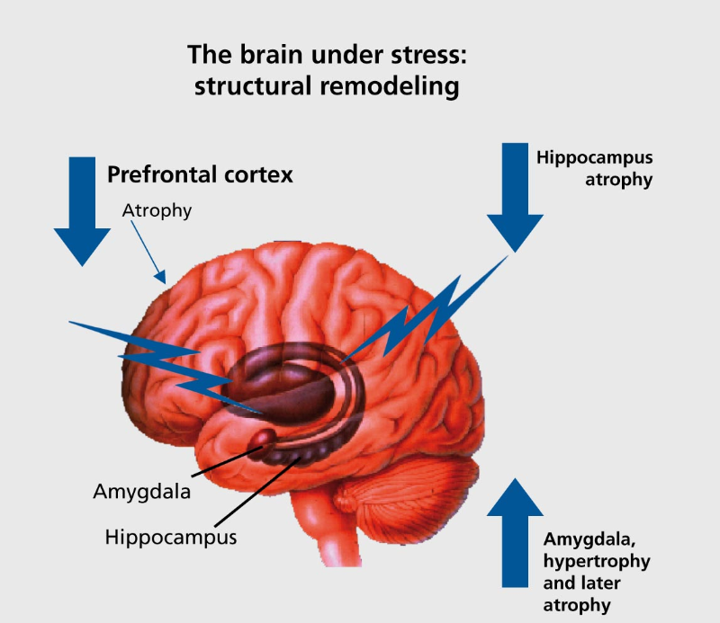
Stressor activates
the Amygdala
HPA Axis
Release of Cortisol
Heart races
Blood goes to muscles
Digestion shuts down Memory impacted
Notes:
The brain under stress: structural remodeling
This slide provides a side-view image of the brain, labeling the prefrontal cortex, hippocampus and amygdala. There are three arrows around the image. The arrow near the Prefrontal cortex points down and has the word “atrophy’ next to it. The arrow next to “hippocampus” also points down and says “atrophy.” The arrow near the work amygdala points up and reads “amygdala, hypertrophy and later atrophy.”
The simple flowchart to the right of the image starts with “stressor activates the amygdala” with an arrow to the words “HPA Axis,” another arrow leading to words “release of cortisol” and after the last arrow, the words “heart races, blood goes to muscle, digestion shuts down, memory impacted.”

Slide 22
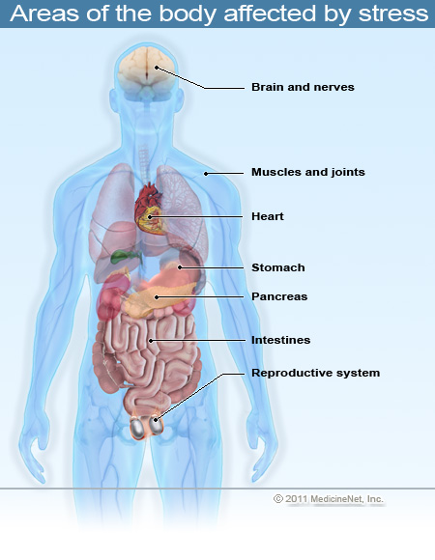
Notes:
Areas of the body affected by stress
Silhouette image of a human body with images internal organs.
The following organs and systems are labeled:
Brain and nerves
Muscles and joints
Heart
Stomach
Pancreast
Intestines
Reproductive system

Slide 23
Allostatic Load
The “wear and tear on the body" which grows over time when the individual is exposed to repeated or chronic stress
Physiological consequences of fluctuating or heightened neural or neuroendocrine response that results from repeated or chronic stress
Frequent activation of the body's stress response, essential for managing acute threats, can in fact damage the body in the long run.
McEwen and Stellar, 1993

Slide 24
The Impact of Trauma is dramatically underestimated

Slide 25
Short Term Consequences
Notes:
Short Term Consequences
Slide shows an image of a month of days from a calendar.

Slide 26
Behavioral Aftermath
Difficulty trusting others
Isolation
Missing work, classes, appointments
Using alcohol or drugs as a way to cope

Slide 27
Psychological Aftermath
Disbelief, numbness, or shock
Shame, guilt, or self-blame
Anxiety, sadness, or anger
Confusion or helplessness
Fear of lack of safety
Difficulty concentrating

Slide 28
Long Term Consequences
Mental Health
Physical Health
Behavioral Health
Early Mortality

Slide 29
Why? What’s the relationship among trauma and poor health outcomes?

Slide 30
The Adverse Childhood Experience (ACE) Study
Over 17,000 Kaiser patients having routine health screenings volunteered to participate in the study.
Data continues to be analyzed
Staggering proof of the health, social, and economic risks that result from childhood trauma

Slide 31
What is an ACE? 10 types of childhood trauma measured in the ACE Study
Five are personal:
Physical abuse
Verbal abuse
Sexual abuse
Physical neglect
Emotional neglect
Five are related to other family members:
A parent who’s an alcoholic
A mother who’s a victim of domestic violence
A family member in jail or prison
A family member diagnosed with a mental illness
The disappearance of a parent through divorce, death or abandonment
Notes:
What is an ACE?
10 types of childhood trauma measured in the ACE Study
Five are personal:
Physical abuse
Verbal abuse
Sexual abuse
Physical neglect
Emotional neglect
Five are related to other family members:
A parent who’s an alcoholic
A mother who’s a victim of domestic violence
A family member in jail or prison
A family member diagnosed with a mental illness
The disappearance of a parent through divorce, death or abandonment
What is an ACE?
10 types of childhood trauma measured in the ACE Study
Five are personal:
Physical abuse
Verbal abuse
Sexual abuse
Physical neglect
Emotional neglect
Five are related to other family members:
A parent who’s an alcoholic
A mother who’s a victim of domestic violence
A family member in jail or prison
A family member diagnosed with a mental illness
The disappearance of a parent through divorce, death or abandonment

Slide 32
ACE Scores
Number of categories (not events) is summed
2 out of 3 experienced at least one category of ACE
If any one ACE is present, there is an 87% chance at least one other category of ACE is present
Anda, Robert F. M.D., & Felitti, Vincent J. M.D. (July 2011). Adverse Childhood Experiences and their
Relationship to Adult Well-being and Disease: Turning Gold into Lead. [PowerPoint slides]
ACE Score Prevalence
0 33%
1 25%
2 15%
3 10%
4 6%
5 or more 11%*
*Women are 50% more likely to have a score >5.
Notes:
ACE Scores
Number of categories (not events) is summed
2 out of 3 experienced at least one category of ACE
If any one ACE is present, there is an 87% chance at least one other category of ACE is present
ACE Score Prevalence
0 33%
1 25%
2 15%
3 10%
4 6%
5 or more 11%
Women are 50% more likely to have a score >5.

Slide 33
The Philadelphia Urban ACE Study
The Institute for Safe Families examined the prevalence and impact of ACEs in Philadelphia, an urban city with a socially and racially diverse population.
1,784 adults completed the Philadelphia Urban ACE Survey
Found a higher prevalence of ACEs than found in previous studies
33.2% of Philadelphia adults experienced emotional abuse
35% experienced physical abuse during their childhood
35% of adults grew up in a household with a substance-abusing member
24.1% lived in a household with someone who was mentally ill
12.9% lived in a household with someone who served time or was sentenced to serve time in prison

Slide 34
The Philadelphia Urban ACE Study
Survey also examined the stressors that exist in the communities where people live.
The study found:
40.5% of Philadelphia adults witnessed violence while growing up, which includes seeing or hearing someone being beaten, stabbed or shot.
34.5% reported experiencing discrimination based on their race or ethnicity
27.3% reported having felt unsafe in their neighborhoods or not trusting their neighbors during childhood
Over 37% of Philadelphia respondents reported four or more ACEs
The findings suggest the need for services that address the unique environmental stressors experienced in urban neighborhoods to mitigate their impact on individuals and prevent ACEs.
http://www.instituteforsafefamilies.org

Slide 35
ACE Study Findings
As the number of ACEs increase, the risk for health problems including chronic diseases such as autoimmune disease, COPD, frequent headaches, health-related quality of life, ischemic heart disease, liver disease and lung cancer, increase in a strong and graded fashion.

Slide 36
Adverse Childhood Experiences ACEs have a strong influence on:
Adolescent health
Teen pregnancy
Smoking
Alcohol abuse
Illicit drug abuse
Sexual behavior
Mental health
Risk of revictimization
Stability of relationships
Performance in the workforce

Slide 37
Notes:
A bar chart is titled: Childhood Experiences vs. Adult Alcoholism
The left side of the graph shows % Alcoholic
The bottom of the graph shows ACE Score
The first bar is colored in brown. It is at the 2.5% area on the chart. The score inside the bar is 0.
The second bar is colored in green. It is at the 5.0% area on the chart. The score inside the bar is 1.
The third bar is colored in red. It is at the 10% area on the chart. The score inside the bar is 2.
The fourth bar is colored in dark blue. It is at the 11% area on the chart. The score inside the bar is 3.
The fifth bar is colored in bright pink. It is at the 16% area on the chart. The score inside the bar is 4+.

Slide 38
Notes:
A bar chart is titled Childhood Experiences Underlie Chronic Depression
The left side of the chart shows % With a Lifetime History of Depression.
The bottom of the chart shows ACE Score.
The chart shows data for Women in red and data for men in yellow.
The data shows the following:
For men, with a 10% Lifetime History of Depression, their ACE score is 0.
For women with about an 18% Lifetime History of Depression, their ACE score is 0.
For men with about a 20% Lifetime History of Depression, their ACE score is 1.
For women with about a 15% Lifetime History of Depression, their ACE score is 1.
For men with about a 25% Lifetime History of Depression, their ACE score is 2.
For women with about a 35% Lifetime History of Depression, their ACE score is 2.
For men with a 30% Lifetime History of Depression, their ACE score is 3.
For women with about a 42% Lifetime History of Depression, their ACE score is 3.
For men with a 35% Lifetime History of Depression, their ACE score is 4.
For women with a 57% Lifetime History of Depression, their ACE score is 4.

Slide 39
Notes:
A bar chart is titled Childhood Experiences Underlie Suicide Attempts
The left side of the chart shows % of Attempting Suicide and the bottom of the chart shows the ACE score.
A 2% Attempted Suicide rate has an ACE score of 0.
A 3% Attempted Suicide rate has an ACE score of 1.
About a 5% Attempted Suicide rate has an ACE score of 2.
An 11% Attempted Suicide rate has an ACE score of 3.
About an 18% Attempted Suicide rate has an ACE score of 4+.

Slide 40
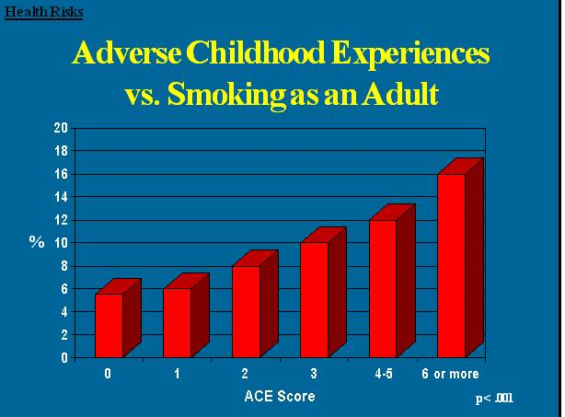
Notes:
A bar chart is titled Adverse Childhood Experiences vs. Smoking as an Adult
The left side of the chart shows % and the bottom of the chart shows the ACE score.
A 6% rate of Smoking as an Adult shows an ACE score of 0.
A 7% rate of Smoking as an Adult shows an ACE score of 1.
A 9% rate of Smoking as an Adult shows an ACE score of 2.
A 11% rate of Smoking as an Adult shows an ACE score of 3.
A 13% rate of Smoking as an Adult shows an ACE score of 4-5.
A 17% rate of Smoking as an Adult shows an ACE score of 6 or more.

Slide 41
Notes:
A bar chart is titled Childhood Experiences Underlie Later Being Raped
The left side of the chart shows % Reporting Rape and the bottom of the chart shows the ACE Score.
A 5% rate of Reporting Rape has an ACE Score of 0.
A 10% rate of Reporting Rape has an ACE Score of 1.
A 16% rate of Reporting Rape has an ACE Score of 2.
A 18% rate of Reporting Rape has an ACE Score of 3.
A 32% rate of Reporting Rape has an ACE Score of 4+.

Slide 42
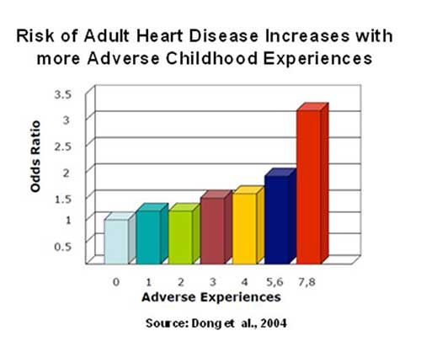
Notes:
A bar chart is titled Risk of Adult Heart Disease Increases with more Adverse Childhood Experiences
The left side of the chart shows Odds Ratio and the bottom of the chart shows Adverse Experiences .
Source: Dong et al., 2004.
An Adverse Experience of 0, the Odds Ratio of Risk of Adult Heart Disease is 1.
An Adverse Experience of 1, the Odds Ratio of Risk of Adult Heart Disease is 1.3.
An Adverse Experience of 2, the Odds Ratio of Risk of Adult Heart Disease is 1.2.
An Adverse Experience of 3, the Odds Ratio of Risk of Adult Heart Disease is 1.5.
An Adverse Experience of 4, the Odds Ratio of Risk of Adult Heart Disease is 1.6.
An Adverse Experience of 5 or 6, the Odds Ratio of Risk of Adult Heart Disease is 1.9.
An Adverse Experience of 7 or 8, the Odds Ratio of Risk of Adult Heart Disease is 3.2.

Slide 43
The ACE Score and Risk Factors for HIV/AIDS
The risk factors for transmission of HIV, are well known.
Less well known is that ACEs are a major hidden “engine” underlying these preventable risk factors for the transmission of HIV.
Injected drug use
50 or more lifetime sexual partners
Ever having a sexually transmitted disease (including AIDs)
All increase dramatically as the ACE Score increases
Anda, 2001

Slide 44
IV Drug Use
The relationship of IV drug use to adverse childhood experiences is powerful and graded - it is a perfect dose-response curve.
A male child with an ACE Score of 6 has a 4,600% increase in the likelihood of later becoming an IV drug user when compared to a male child with an ACE Score of 0.
Felitti, German ACE article

Slide 45
ACE Study Findings Sexually Transmitted Infections
There is a 250% increase in the odds of having a sexually transmitted infections between individuals with an ACE Score of 4 compared to those with an ACE Score of 0.
http://www.acestudy.org/

Slide 46
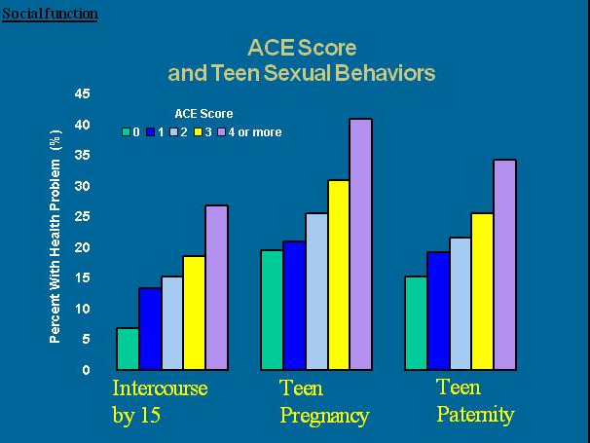
Notes:
A bar chart is titled ACE Score and Teen Sexual Behavior
The left side of the chart shows Percent with Health Problem. The bottom of the chart shows Intercourse by 15, Teen Pregnancy, and Teen Paternity.
Above each of these areas, it shows the ACE Scores in colors. Green is an ACE Score of 0, Blue is an ACE Score of 1, Light Blue is an ACE Score of 2, Yellow is an ACE Score of 3, and Purple is an ACE Score of 4 or more.
The data shows:
Intercourse by Age 15 shows a range of Health Problems from 5% to 27% with the higher the ACE Score, the higher the percentage of Health Problems.
Teen Pregnancy shows a range of Health Problems from 20% to 40% with the higher the ACE Score, the higher the percentage of Health Problems.
Teen Paternity shows a range of Health Problems from 15% to about 34% with the higher the ACE Score, the higher the percentage of Health Problems.

Slide 47
Adverse Childhood Experiences and Sexual Risk Behaviors in Women: A Retrospective Cohort Study
.
Susan D. Hillis, Robert F. Anda, Vincent J. Felitti and Polly A. Marchbanks
Conclusions:
Among individuals with a history of adverse childhood experiences, risky sexual behavior may represent their attempts to achieve intimate interpersonal connections. Having grown up in families unable to provide needed protection, such individuals may be unprepared to protect themselves and may underestimate the risks they take in their attempts to achieve intimacy. If so, coping with such problems represents a serious public health challenge.
Family Planning Perspectives, 2001

Slide 48
The ACE Pyramid
Notes:
A graphic in the shape of a pyramid with 5 blocks one on top of the other and titled The ACE Pyramid.
The left side of the pyramid has an orange arrow pointing up that says Whole Life Perspective and at the bottom of this arrow is the word Conception.
The bottom block of the pyramid is Adverse Childhood Experiences in blue.
The next block is Social, Emotional & Cognitive Impairment in purple.
The next block is Adoption of Health-risk Behaviors in lavender.
The next block is Disease, Disability and Social Behaviors in red.
The top block is Early Death.
Along the right side of the pyramid are the words Scientific Gaps with curved arrows in between the Adverse Childhood Experiences; Social, Emotional & Cognitive Impairment; and Adoption of Health-risk Behaviors blocks.

Slide 49
High Risk Behavior or Coping?

Slide 50
A quote from Dr. Felitti: “It’s hard to give something up that almost works.”

Slide 51
In Summary, the ACE Study indicates…
Adverse childhood experiences are the most basic and long lasting determinants of health risk behaviors, mental illness, social malfunction, disease, disability, death, and healthcare costs.
Anda, Robert F. M.D., & Felitti, Vincent J. M.D. (July 2011). Adverse Childhood Experiences and their Relationship to Adult Well-being and Disease:
Turning Gold into Lead.

Slide 52
What does this look like in the clinical setting?

Slide 53
Utilization of Medical Services
Survivors have higher utilization of medical services and report a greater number of physical health problems
Sources: Kartha et al., 2008; Lesserman, et al., 2006;
Letourneau, Holmes, & Chasendunn-Roark, 1999; Nicolaidis, et al., 2004;
Sadler, et al, 2000; Sledjeski, Speisman & Dierker (2008)

Slide 54
Utilization of Preventive Care
Trauma survivors are less likely:
To obtain regular mammograms
To obtain regular cervical cancer screenings
To attend regular dental appointments
Sources: Farley, Golding, & Minkoff (2002); Farley, Minkoff, & Barkan (2001); Farley & Patsalides (2001)

Slide 55
Secondary Victimization
Also known as the “Second Rape” or “Retraumatization”
Victimization which occurs, not as a direct result of the criminal act, but through the response of institutions and individuals to the victim
Sources: Campbell & Wasco (2005); Campbell & Raja (2005); Campbell, Wasco, Ahrens, et.al, (2001)

Slide 56
The Results of Secondary Victimization
Actually increases symptoms
Keeps patients/clients from seeking or benefitting fully from the care they need
Sources: Campbell & Wasco (2005); Campbell & Raja (2005); Campbell, Wasco, Ahrens, et.al, (2001); Ullman & Filipas, 2001

Slide 57
Specific Examples
Physical Exams
OB/Gyn
Sleep clinics
Ophthalmology
ER visits
A Surgical Procedure
Feeling out of control during sedation
Strangers present while unconscious

Slide 58
What Helps to Create Favorable Outcomes?
No prior trauma history
Resiliency
Social support
A sense of life purpose
A feeling of mastery
Religious coping
Trauma-informed care and services

Slide 59
Trauma-Informed Care
Words, actions, and policies have the ability to hurt or heal

Slide 60
What is Trauma-Informed Care?
Every part of a service, agency or institution from front desk staff, administrators, to care providers is assessed and potentially modified to include a basic understanding of how trauma impacts the life of an individual seeking services and provides services so as to prevent retraumatization and optimize opportunity for the individual to benefit from care and services.

Slide 61
Trauma-informed Services
Trauma-informed services:
Take the trauma into account
Avoid triggering trauma reactions and/or
retraumatizing the individual
Adjust the behavior of providers, other staff and
the organization to support the individual’s coping
capacity
Allow survivors to manage their trauma symptoms successfully so that they are able to access, retain and benefit from the services
(Harris & Fallot)

Slide 62
“Universal Precautions”
Exposure to trauma is pervasive
The impact of trauma is dramatically underestimated
Therefore, assume EVERYONE has a trauma history.

Slide 63
Trauma-Informed Care
Paradigm shift from…
What’s wrong with you?
to
What happened to you?

Slide 64
The Trauma-Informed Care Pyramid
Raja, S., Hoersch, M., et al. (2014). JADA
Notes:
A pyramid with 5 blocks titled the Trauma-Informed Care Pyramid.
The first block at the bottom is Patient-Centered Communication Skills in dark purple.
The second block is Understanding the Health Effects of Trauma in green.
The third block is Collaboration and Understanding Your Professional Role in orange.
The fourth block is Understanding Your Own History in blue.
The fifth block is Screening in red.
Source: Raja, S., Hoersch, M., et al. (2014), JADA

Slide 65
Trauma Stewardship

Slide 66
Success Stories
Colorado
Wisconsin
Truman Medical College
Head Start
Tarpon Springs, FL

Slide 67
Training Health Care Providers
Trauma-Informed Care for Health Care Providers:
On-line Clinical Cases
To increase knowledge and skills in trauma-informed care
Interactive case-based learning
Free-standing cases allow providers to self-tailor CMEs
Evidenced-based

Slide 68
Trauma-Informed Care for Health Care Providers: On-line Clinical Cases
Introductory Cases
Preventive care visit
Acute care visit
Chronic disease management
Subsequent Cases
Prenatal
Obstetric
Post-partum
Pelvic exams with STI testing
ER
Hospitalization
Ophthalmologic care
Pain clinic
Sleep clinic
Office Procedures – biopsies cardiac imaging
Surgical care
Women Veterans
Incarcerated and recently released
Elderly
LGBTQ
Pediatric

Slide 69
Women and Trauma Federal Partners Committee
Building a Trauma Informed Nation: Moving from Conversation to Action
Webcast Event and local stakeholder convenings
September 29-30, 2015

Slide 70
Resources
National Center for Trauma-Informed Care http://beta.samhsa.gov/nctic
ACEStudy.org
ACEStoohigh.com
Wisconsin Department of Health Services –Trauma-informed Care Website www.dhs.wisconsin.gov/tic/principles.htm

Slide 71
Questions and Comments

Slide 72
Contact Info
Michelle D. Hoersch, MS
Office on Women's Health - Region V
U.S. Department of Health and Human Services
312-353-8122
michelle.hoersch@hhs.gov
www.womenshealth.gov

